Slide 1
Building End-To-End Dialogue Systems Using Generative Hierarchical Neural Network Models
Iulian V. Serban*, Alessandro Sordoni*, Yoshua Bengio1*, Aaron Courville* ,
^{Joelle Pineau†}
By GuoTongLei

Slide 2
Outline
PPT模板下载：www.1ppt.com/moban/ 行业PPT模板：www.1ppt.com/hangye/
节日PPT模板：www.1ppt.com/jieri/ PPT素材下载：www.1ppt.com/sucai/
PPT背景图片：www.1ppt.com/beijing/ PPT图表下载：www.1ppt.com/tubiao/
优秀PPT下载：www.1ppt.com/xiazai/ PPT教程： www.1ppt.com/powerpoint/
Word教程： www.1ppt.com/word/ Excel教程：www.1ppt.com/excel/
资料下载：www.1ppt.com/ziliao/ PPT课件下载：www.1ppt.com/kejian/
范文下载：www.1ppt.com/fanwen/ 试卷下载：www.1ppt.com/shiti/
教案下载：www.1ppt.com/jiaoan/ PPT论坛：www.1ppt.cn
01
Introduction
02
Models
目录
CONTENTS
03
04
Dataset
Experiments

Slide 3
Introduction
最 Dialogue systems classification作
^{goal-driven systems}
hand-crafted features and action space representations
a large annotated task-specific corpus or a horde of human expensive and time-consuming limited usage to a narrow domain.
^{e.g} partially observable Markov decision process (POMDP)
有些懈怠，事情比较多比较杂，搅在一起让人丧失了动力

Slide 4
Introduction
最 ^{Dialogue systems} ^{classification}
^{non-goal- driven systems}
may be deployed directly for tasks which do not naturally exhibit a directly measurable goal or simply for entertainment.
can be used to train a user simulator, which can then train the POMDP models.
the extracted features may be used to expand the state space representation of POMDP models.

Slide 5
Introduction
最^{contribution}
Define the generative dialogue problem as modeling the utterances and interactive structure of the dialogue.
Contrary to explanation-based and rule-based inference systems, our model does not require a predefined state or action space representation.
Focus on models which can be trained efficiently on large datasets and which are able to maintain state over long conversations.

Slide 6
Outline
PPT模板下载：www.1ppt.com/moban/ 行业PPT模板：www.1ppt.com/hangye/
节日PPT模板：www.1ppt.com/jieri/ PPT素材下载：www.1ppt.com/sucai/
PPT背景图片：www.1ppt.com/beijing/ PPT图表下载：www.1ppt.com/tubiao/
优秀PPT下载：www.1ppt.com/xiazai/ PPT教程： www.1ppt.com/powerpoint/
Word教程： www.1ppt.com/word/ Excel教程：www.1ppt.com/excel/
资料下载：www.1ppt.com/ziliao/ PPT课件下载：www.1ppt.com/kejian/
范文下载：www.1ppt.com/fanwen/ 试卷下载：www.1ppt.com/shiti/
教案下载：www.1ppt.com/jiaoan/ PPT论坛：www.1ppt.cn
01
Introduction
02
Models
目录
CONTENTS
03
04
Dataset
Experiments

Slide 7



Models
^{D -} ^{dialogue} ^{U -} ^{utterances w –} ^{token}
A generative model of dialogue parameterizes a probability distribution over the set of all possible dialogues of arbitrary lengths.

Slide 8
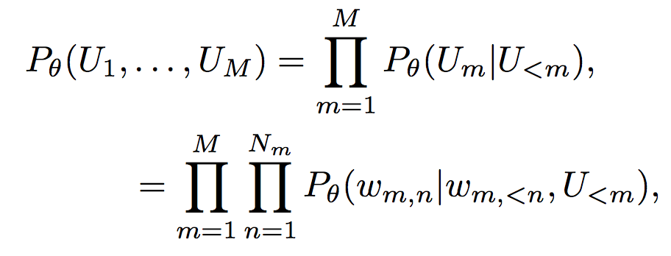
Models
The probability of a dialogue D :

Slide 9

Models
Sampling one word at a time from the conditional distribution conditioned on the previously sampled words.
Using word embeddings to avoid the curse of dimensionality in n-garms.

Slide 10

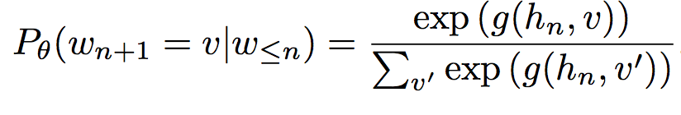
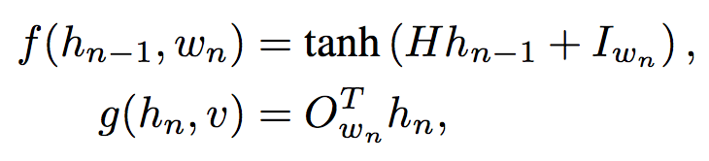
Models
^{Recurrent Neural Network}
^{hidden} state is used to encoded the context information
the context information is used to predict the next token in the sentence

Slide 11
Models
Hierarchical Recurrent Encoder-Decoder (HRED)
^{Hierarchy -} the history of past submitted queries :
a sequence of words for each web query
^{a sequence of queries}
^{HRED models it with two RNNs:}
^{word level + query level}
A dialogue can be seen as a sequence of utterances which, in turn, are sequences of tokens.

Slide 12
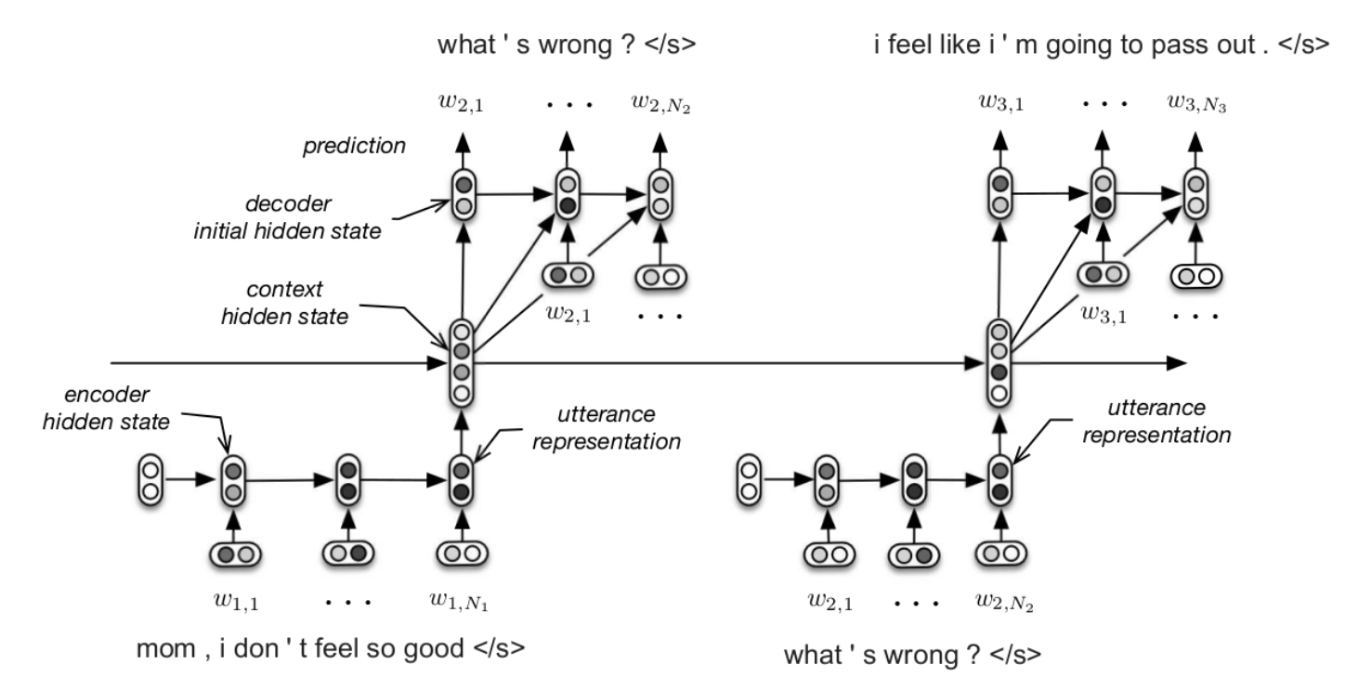
Models
Hierarchical Recurrent Encoder-Decoder (HRED)

Slide 13
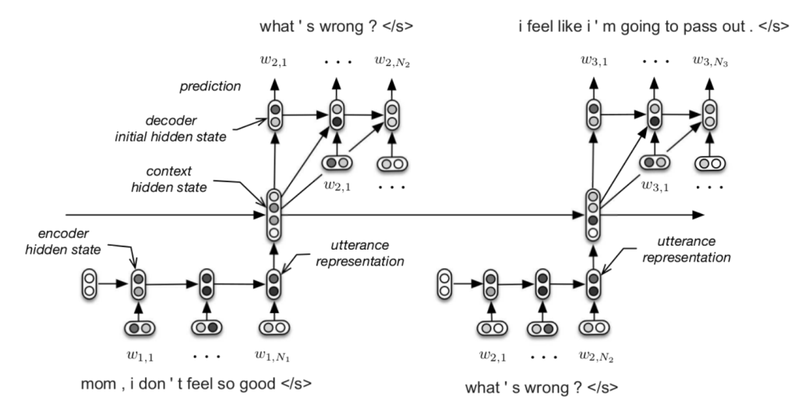
Models
Hierarchical Recurrent Encoder-Decoder (HRED)
Encoder RNN maps each utterance to an utterance vector
Context RNN represents a summary of the dialogue
^{Decoder RNN} ^{predict the next utterance}
Make use of the GRU hidden unit
Use the hyperbolic tangent as activation function
The same encoder RNN and decoder RNN parameters are used for every utterance in a dialogue

Slide 14

Models
^{Bidirectional HRED}
^{HRED’s problem:}
For long utterances, the last state of the encoder RNN may not reflect important information seen at the beginning of the utterance.
Bidirectional RNNs run two chains: forward + backward
Two ways to obtain a fixed-length representation for the utterance:
1) taking the concatenation of the last state of each RNN.
2) applying L2 pooling over the temporal dimension of each chain, and taking the concatenation of the two pooled states.

Slide 15
Models
Hierarchical Recurrent Encoder-Decoder (HRED)
^{Why HRED model is} superior to the standard RNN model ?
The context RNN allows the model to represent a form of common ground between speakers.
The number of computational steps between utterances is reduced, makes the objective function more stable w.r.t. the model parameters.

Slide 16
Models
Bootstrapping from Word Embeddings
^{and Subtitles Q-A}
Learning word embeddings from larger corpora
To learn a good initialization point for all model parameters, further pretrain the model on a large non-dialogue corpus.

Slide 17
Outline
PPT模板下载：www.1ppt.com/moban/ 行业PPT模板：www.1ppt.com/hangye/
节日PPT模板：www.1ppt.com/jieri/ PPT素材下载：www.1ppt.com/sucai/
PPT背景图片：www.1ppt.com/beijing/ PPT图表下载：www.1ppt.com/tubiao/
优秀PPT下载：www.1ppt.com/xiazai/ PPT教程： www.1ppt.com/powerpoint/
Word教程： www.1ppt.com/word/ Excel教程：www.1ppt.com/excel/
资料下载：www.1ppt.com/ziliao/ PPT课件下载：www.1ppt.com/kejian/
范文下载：www.1ppt.com/fanwen/ 试卷下载：www.1ppt.com/shiti/
教案下载：www.1ppt.com/jiaoan/ PPT论坛：www.1ppt.cn
01
Introduction
02
Models
目录
CONTENTS
03
04
Dataset
Experiments

Slide 18
Dataset
^{The MovieTriples dataset}
Used the Python-based natural language toolkit NLTK to perform tokenization and named-entity recognition
^{generated “triples” {U}₁^{, U}₂^{, U}₃}
a special end-of-utterance token, ^{a continued-utterance token}
first split the movies into training, validation and test set, and then construct the triples.

Slide 19
Outline
PPT模板下载：www.1ppt.com/moban/ 行业PPT模板：www.1ppt.com/hangye/
节日PPT模板：www.1ppt.com/jieri/ PPT素材下载：www.1ppt.com/sucai/
PPT背景图片：www.1ppt.com/beijing/ PPT图表下载：www.1ppt.com/tubiao/
优秀PPT下载：www.1ppt.com/xiazai/ PPT教程： www.1ppt.com/powerpoint/
Word教程： www.1ppt.com/word/ Excel教程：www.1ppt.com/excel/
资料下载：www.1ppt.com/ziliao/ PPT课件下载：www.1ppt.com/kejian/
范文下载：www.1ppt.com/fanwen/ 试卷下载：www.1ppt.com/shiti/
教案下载：www.1ppt.com/jiaoan/ PPT论坛：www.1ppt.cn
01
Introduction
02
Models
目录
CONTENTS
03
04
Dataset
Experiments

Slide 20
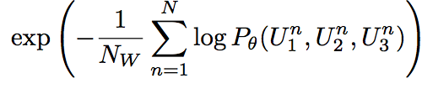
Experiments
^{Evaluation Metrics}
probabilistic language models word perplexity
^{word perplexity}
Measures the model’s ability to account for the
syntactic structure of the dialogue.
Lower perplexity is indicative of a better model.
word classification error / word error-rate
The number of words in the dataset the model has predicted incorrectly divided by the total number of words in the dataset.

Slide 21
Experiments
^{Training Procedure}
Optimized the log- likelihood of the triples using Adam optimizer
The best hyperparameters of the models were chosen by early stopping with patience on the validation set perplexity.
Initialized the recurrent parameter matrices as orthogonal matrices, and all other parameters from a Gaussian random distribution with mean zero and standard deviation 0.01.
^{Special dialogue tokens} were initialized from a Gaussian random distribution

Slide 22
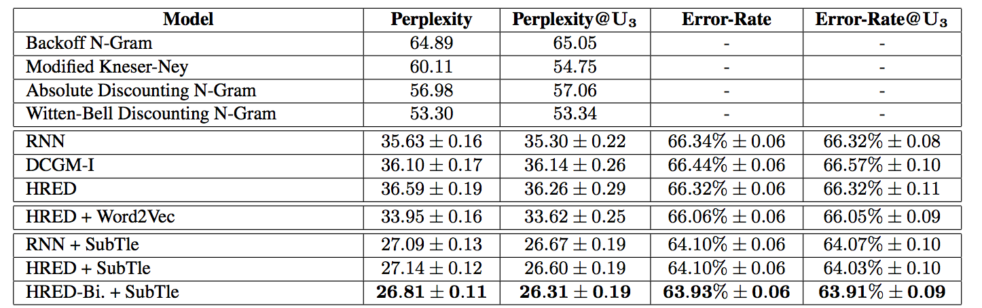
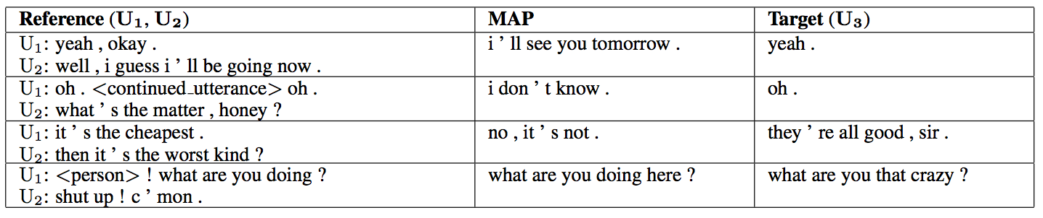
Experiments
the use of beam-search for RNNs to approximate the most probable (MAP) last utterance

Slide 23
THANKS

